Slide 1
Complexity Theory-II
Data structures

Slide 2
Constant Factors
The growth rate is not affected by
Constant factors or
Lower-order terms
Examples
10²n + 10⁵ is a linear function
10⁵n² + 10⁸n is a quadratic function

Slide 3
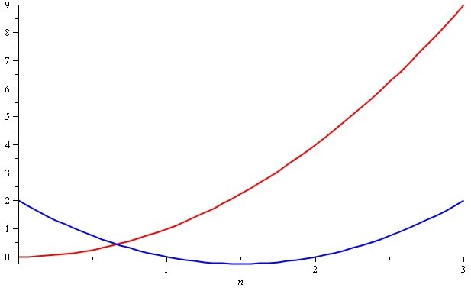
Growth Rate – Example
Consider the two functions
f(n)=n²
g(n)=n²–3n+2
Around n = 0, they look very different

Slide 4
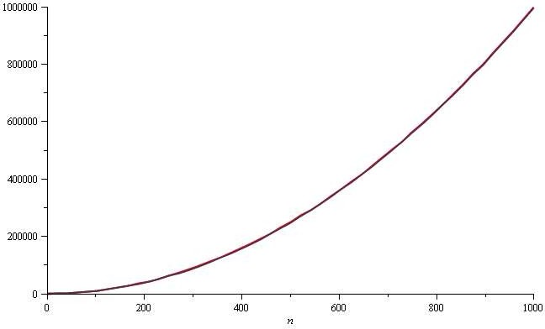
Growth Rate – Example
Yet on the range n = [0, 1000], f(n) and g(n) are (relatively) indistinguishable

Slide 5
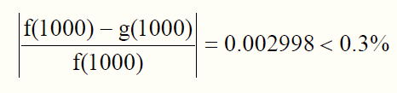
Growth Rate – Example
The absolute difference is large, for example,
f(1000)=1000000
g(1000)=997002
But the relative difference is very small
The difference goes to zero as n → ∞
Notes:
Relative difference compares one value to another. It is helpful in determining the percentage increase or decrease from one value to another.

Slide 6
Constant Factors
How do we get rid of the constant factors to focus on the essential part of the running time?
Asymptotic Analysis

Slide 7
Asymptotic Analysis
In computer science and applied mathematics, particularly the analysis of algorithms, asymptotic analysis is a method of describing limiting behavior.
Examples The performance of algorithms when applied to very large input data

Slide 8
Comparing Functions: Asymptotic Notation
Big Oh Notation: Upper bound (worst case)
Omega Notation: Lower bound (best case)
Theta Notation: Tighter bound (average case)

Slide 9
Upper Bound – Big-Oh Notation
Indicates the upper or highest growth rate that the algorithm can have
Ignore constant factors and lower order terms
Focus on main components of a function which affect its growth

Slide 10
Upper Bound – Big-Oh Notation
If f(N) and g(N) are two complexity functions, we say
f(n) = O(g(n))
(read "f(n) is big-O of g(n)")
There are positive constants c and n₀ such that
f(n) ≤ c g(n) when n ≥ n₀
The growth rate of f(n) is less than or equal to the growth rate of g(n). In other words, f(n) grows no faster than g(n) for large N.
g(n) is an upper bound on f(n).

Slide 11
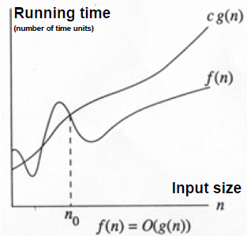
Growth Rate of the Algorithm Running Time

Slide 12
Big-Oh Notation Rules
When considering the growth rate of a function using Big-Oh notation,
we ignore the lower order terms
We ignore the coefficients of the highest-order term; and
we don’t need to specify the base of logarithm
Note that changing the base from one constant to another changes the value of the logarithm by only a constant factor

Slide 13
Example
N² / 2 – 3N = O(N²)
(We throw away leading constants and low-order terms.)
1+4N = O(N)
7 N² + 10N + 3 = O(N²)
log N + N = O(N)

Slide 14
Big-Oh Notation
Example: 2n + 10 is O(n)
2n + 10 ≤ cn
10 ≤ cn – 2n
(c − 2) n ≥ 10
n ≥ 10/(c − 2)
Pick c = 3 and n₀ = 10

Slide 15
Big-Oh Example
Example: the function n² is not O(n)
n² ≤ cn
n ≤ c
The above inequality cannot be satisfied since c must be a constant and n can take any non-negative integral value

Slide 16
Big-Oh Examples
7n-2 is O(n)
need to find two positive constants: c, n₀, such that for all n ≥ n₀
7n-2 ≤ c•n
c = 7 and n₀ = 1
3n³ + 20n² + 5 is O(n³)
need to find two positive constants: c, n₀, such that for all n ≥ n₀
3n³ + 20n² + 5 ≤ c•n³
c = 4 and n₀ = 21
3 log n + log log n is O(log n)
need to find two positive constants: c, n₀, such that
3 log n + log log n ≤ c•log n for all n ≥ n₀
this is true for c = 4 and n₀ = 2

Slide 17
Analyzing an Algorithm
Simple Assignment
a = b
O(1)
Simple loops
for(i=0; i<n; i++) { s; }
O(n)
Nested loops
for(i=0; i<n; i++)
for(j=0; j<n; j++) { s; }
O(n²)

Slide 18
Analyzing an Algorithm
Loop index doesn’t vary linearly
h=1;
while(h<=n){
s;
h=2*h;
}
h takes values 1, 2, 4, … until it exceeds n
There are 1 + log₂n iterations
O(log₂n)

Slide 19
Standard Analysis Techniques
Constant time statements
Analyzing Loops
Analyzing Nested Loops
Analyzing Sequence of Statements
Analyzing Conditional Statements

Slide 20
Constant time statements
Simplest case: O(1) time statements
Assignment statements of simple data types int x = y;
Arithmetic operations: x = 5 * y + 4 - z;
Array assignment: A[j] = 5;
Most conditional tests: if (x < 12) ...

Slide 21
Analyzing Loops
Any loop has two parts:
How many iterations are performed?
How many steps per iteration?
int sum = 0,j;
for (j=0; j < N; j++)
sum = sum +j;
Loop executes N times (0..N-1)
4 = O(1) steps per iteration
Total time is N * O(1) = O(N*1) = O(N)

Slide 22
Analyzing Nested Loops
Treat just like a single loop and evaluate each level of nesting as needed:
int j,k;
for (j=0; j<N; j++)
for (k=N; k>0; k--)
sum += k+j;
Start with outer loop:
How many iterations? N
How much time per iteration? Need to evaluate inner loop
Inner loop uses O(N) time
Total time is N * O(N) = O(N*N) = O(N²)

Slide 23
Analyzing Sequence of Statements
For a sequence of statements, compute their complexity functions individually and add them up
for (j=0; j < N; j++)
for (k =0; k < j; k++)
sum = sum + j*k;
for (l=0; l < N; l++)
sum = sum -l;
cout<<“Sum=”<<sum;
Total cost is O(N²) + O(N) +O(1) = O(N²)

Slide 24
Analyzing Conditional Statements
What about conditional statements such as
if (condition)
statement1;
else
statement2;
Running time = never more than the running time of the test Condition plus the larger of the running times of Statement1 and Statement2.

Slide 25
Relatives of Big-Oh
Big-Omega
f(n) is Ω(g(n)) is asymptotically greater than or equal to g(n)
If there is a constant c > 0 and an integer constant n₀ > 1
Such that f(n) > c.g(n) for n > n₀
Big-Theta
f(n) is Θ(g(n)) is asymptotically equal to g(n)
if there are constants c₁ > 0 and c₂ > 0 and an integer constant n₀ > 1
such that c₁.g(n) < f(n) < c₂.g(n) for n > n₀

Slide 26
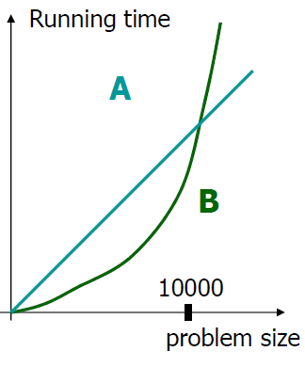
Final Notes
Even though in this course we focus on the asymptotic growth using big-Oh notation, practitioners do care about constant factors occasionally
Suppose we have 2 algorithms
Algorithm A has running time 30000n
Algorithm B has running time 3n2
Asymptotically, algorithm A is better than algorithm B
However, if the problem size you deal with is always less than 10000, then the quadratic one is faster

